Slide 1

ENEL 500: Capstone
Electrical and Software Engineering
Click to add sub-title
Dr. Hamid Zareipour
Professor
https://gridforesight.ca

Slide 2

About me
Joined uCalgary in January 2007.
My research and teaching is focused on optimization, operation and planning of electrical power grids.
Took over the capstone course in 2013, redesigned it into what we have now based on student/industry/business community feedback.
Founding instructor of:
  ENEL 500: Industry Sponsored Capstone
  ENGG 501/502 (Multidisciplinary Capstone), and
  ENGG 503/504 (Entrepreneurial Capstone)

Slide 3
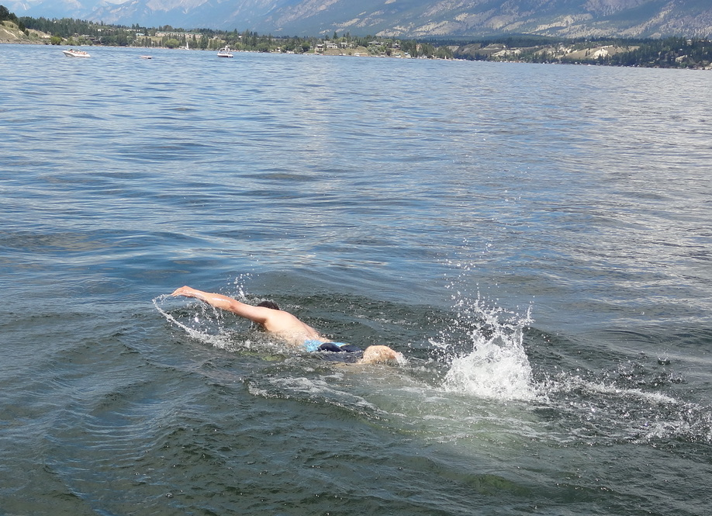
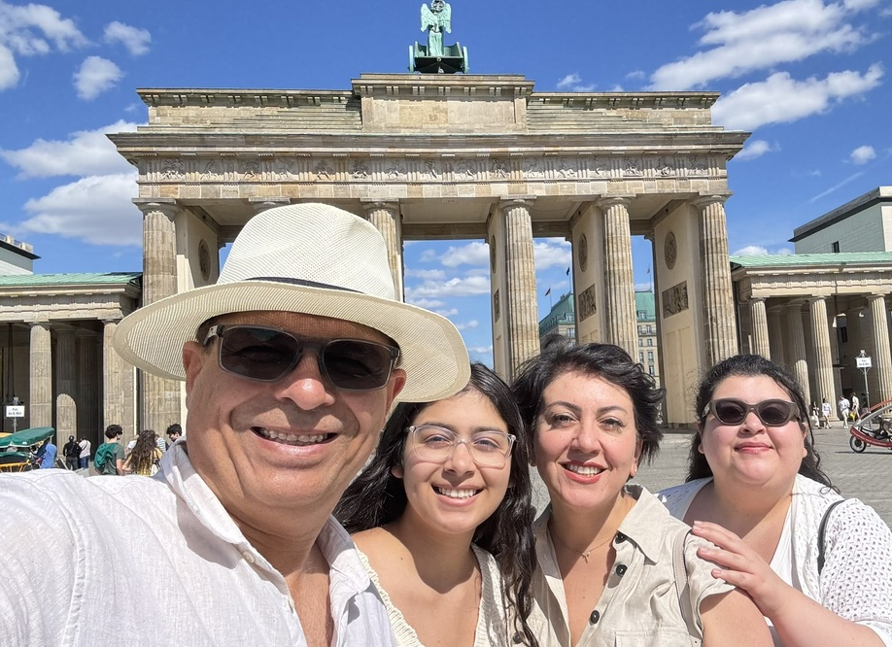
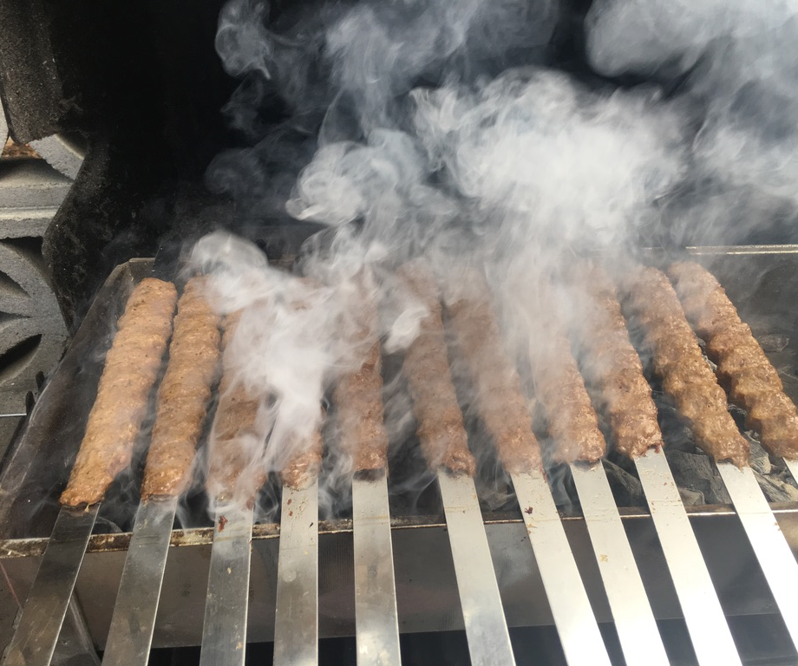
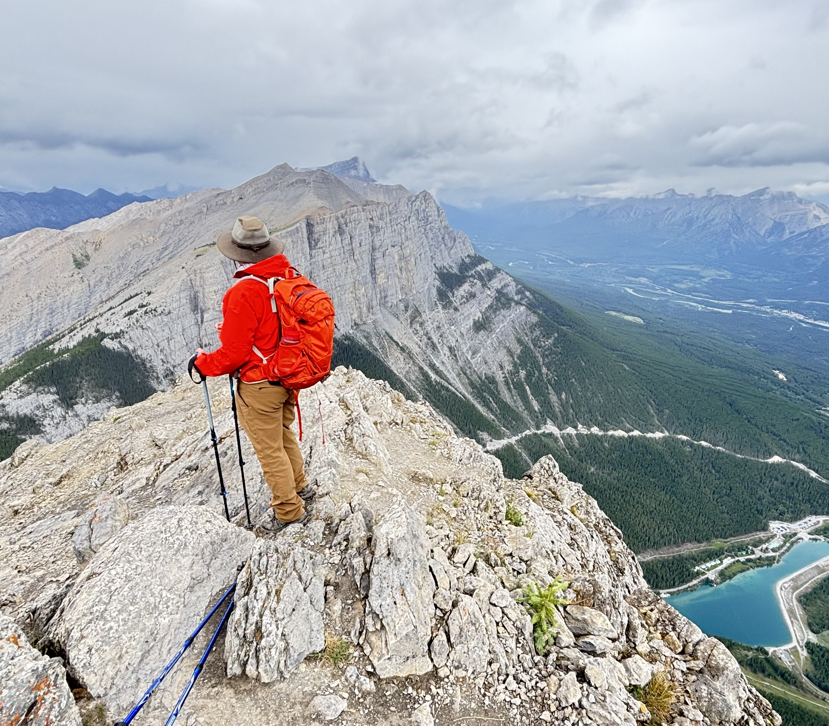
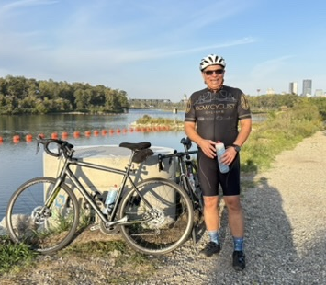

Slide 4

What is ENEL 500?
Two‑term, team‑based engineering design project tackling a real problem.
Emphasis on engineering design & professionalism:
  Problem scoping, requirements, constraints, safety, ethics
  Analysis, prototyping (when feasible), testing & validation
  Communication with stakeholders and documentation
Grades reflect both team outcomes and individual contributions (peer evaluations).

Slide 5
What course suits you?
No industry sponsor? No ENEL!
Research Labs at the University are allowed as a sponsor
Your own idea: Go to ENGG 503/504
Want to join your finds from other programs: Go to ENGG 501/502

Slide 6
What counts as an industry-sponsored project?
A project jointly defined and scoped by your team and an external industry sponsor to solve a real problem in the sponsor’s line of work. The deliverable must be directly relevant to the sponsor and within the technical scope of Electrical & Software Engineering (ESE).

Slide 7
Who can sponsor?
Any organization whose problem aligns with ESE knowledge: engineering and high-tech firms, utilities, oil & gas, food and health sectors, public institutions, and research labs. Sponsors do not need to be in Alberta; local sponsors are preferred for easier meetings and communication.

Slide 8
How to find a sponsor?
Previous employers (internships, co-ops, summer jobs).
Professional & personal networks (friends, relatives, classmates, community contacts).
Internships: your host company may sponsor next year’s capstone.
Help each other: if your internship employer isn’t a fit for your team, they might be perfect for a classmate’s team.

Slide 9
Will the instructor provide projects?
Short answer: no. It is your responsibility to find projects and form a team.
Occasional opportunities: At times, local industry contacts share potential project ideas. When this happens, the course coordinator will post them as they come in via course channels.
Do not wait for postings: The number, scope, and timing of such opportunities are unpredictable, so you should actively pursue your own sponsor.

Slide 10
Quick project eligibility checklist
Engineering design is central — you are creating/adapting an element, system, or process to meet a stated need (not just analyzing or testing).
Teamwork is integral — a multi-person team with defined roles and collaboration.
Project management is practiced — scope, schedule, milestones, risk, and stakeholder communication.
If you can genuinely check all three, you’re on the right track for ESE capstone eligibility.

Slide 11
Process & feedback
The course coordinator provides feedback only after your proposal is officially submitted and reviewed with the full set of proposals (See Initial Project Proposal Submission deadline).
Borderline projects will receive specific tips and guidelines from the instructor and TAs to elevate them to the required level during the initial project proposal review.

Slide 12
Examples to guide your scoping
Qualifies: designing and prototyping an embedded control system for a sponsor’s device; developing and validating a software-hardware data pipeline that meets performance and reliability requirements; re-engineering a process with quantitative trade-off analysis and verification.
Does not qualify (by itself): literature reviews, routine maintenance, pure data collection, or unstructured coding without defined requirements and verification.

Slide 13
Team size & composition
Standard size: 4–6 students per team.
Exception (strict, rare):
  A 7th member may be approved case‑by‑case only if the project scope clearly requires it.
  Submit a written request to the course coordinator with specific justifications well before the initial project proposal deadline.
Pure software/electrical projects:
  The majority of team members should normally be from Software/electrical Engineering.
  If that isn’t possible, email the course coordinator (Dr. Zareipour) to request permission.

Slide 14
Forming your team
Students are responsible for finding/forming a suitable team.
You must bring an eligible project or join a team with an eligible project.
Use the official Discord channel (created by the course coordinator) to connect with classmates and potential teams.
The course coordinator will not form teams and cannot provide placement services.
In very unusual circumstances, the instructor may assign students to existing teams to accommodate exceptional situations.

Slide 15
Team Forming Deadline
Every student must be in a team by the initial project proposal deadline. (See course schedule.)
If you have no teams yet, contact Dr Z. asap!

Slide 16
Initial project proposal submission
Submit: one per team, via D2L, using the provided Excel template.
Writing tips (what reviewers look for):
  Be clear and specific in defining the problem and proposed solution.
  Avoid jargon and undefined technical terms; make it understandable to a non‑expert.
Proofread for grammar and typos.
Eligibility: Demonstrate that the project is a fourth‑year team design project eligible (design is central; see the section on Projects where project eligibility and CEAB requirements are discussed).
If the sponsor provided target deliverables, show where solution design remains open for the team to design/engineer.

Slide 17
After you submit
The Instructor and TAs review proposals.
D2L groups are created for each project by the TAs.
Team members are enrolled into D2L groups by the TAs.
Initial feedback is posted on D2L for each team.

Slide 18
kick‑off meeting with the TA
Who arranges:
The TA will initiate,
The team is responsible for scheduling.
Purpose:
meet‑and‑greet,
walk through the proposal,
discuss initial feedback,
clarify issues,
and align on next steps per the course timeline.

Slide 19
Final Project Proposal
Submit:
The final version of the proposal excel template via D2L by the deadline,
Assessment criteria:
Clarity
Completion of all sections
Evidence that you addressed prior feedback in this final submission
Outcome:
team marks posted the following week;
projects approved/finalized.

Slide 20
Communication Protocol
Official team number format: 500-{TA Initials}-{Number}-{TeamName}
  Example: 500-JD-1-MapLoad → TA John Doe; this is their Team #1; course ENEL 500; team name MapLoad.
Always use your complete team number in all communications with the instructor, TAs, and advisor (email subjects, tickets, documents, and slide decks).
Emails without a complete team number may be delayed or unanswered.
On D2L, your group name is your team number.

Slide 21
Project Manager (a.k.a Team Manager)
Purpose:
Owns logistics and coordination so the team can focus on technical work.
Important clarification: The Project Manager role does not exclude the manager from day‑to‑day technical work. Treat PM duties as an additional layer of responsibility undertaken alongside technical contributions; the benefit is practical leadership experience.
Core responsibilities (non‑exhaustive):
Plan and run meetings (agenda, minutes, action items, owners, due dates).
Maintain the project plan (scope, schedule/milestones, risks, comms cadence).
Coordinate with the industry sponsor representative, academic advisor, TA, and instructor.
Ensure deliverables (proposal, design roadmap, reviews, demo, final report) are submitted on time and in the required formats.
Track decisions and change control; keep stakeholders informed.
Rotation:
The Project Manager role should rotate among team members. You may plan rotations across Fall and Winter terms; the team decides timing.
If you choose one PM for the entire project, that student still participates in technical work—PM duties are additional. The benefit: practical leadership/management experience.

Slide 22
Project Manager (a.k.a Team Manager)
Re‑evaluation:
Any team member may request a PM change review at any time.
The team must take such requests seriously and decide promptly.
Issue escalation: Concerns about the PM ?
Open discussion within the team,
Discuss with your TA.
If unresolved → engage the course instructor.
Shared accountability:
The health and progress of the project is everyone’s responsibility.
Important:
Unresolved disputes left until the end of term may lead to penalties for all team members. Be proactive.

Slide 23
Technical Academic Advisor
Each team must have one formal technical academic advisor.
What “formal advisor” means:
A committed advisor for the full academic year (both semesters),
who will evaluate the team’s technical solutions and attend three evaluation sessions.
Typical workload:
minimum 4–5 hours across the year.
Advisors do not mark reports;
they provide technical guidance,
endorse the technical soundness of your design,
and attend the fall, winter, and final oral project evaluation sessions.
Teams may have multiple advisors (formal and/or informal); however, at least one formal academic advisor is required.
Purpose:
Ensure your technical decisions are sound and that the solution meets ESE standards.
Deadline:
By Project Information Submission Deadline

Slide 24
Industry Sponsor Representative
Assignment: The sponsor must assign the sponsor representative.
All requests, evaluations, and meetings are arranged through this representative.
APEGA membership (EIT or PEng) is strongly recommended.
Engagement expectations:
Keep the sponsor involved in scoping and solution design to avoid surprises.
Meet at least once with the sponsor before finalizing the design roadmap.
Meet/consult as often as necessary, while respecting the representative’s schedule.
Share copies of team reports with the sponsor representative for their information (they do not mark your reports).
Sponsor representative evaluations are part of your grade. They can evaluate fairly only if you keep them informed throughout.
If issues arise:
An unsatisfied sponsor is not an option.
Do your best to keep the sponsor informed and satisfied.
Escalate serious issues early to the TA→course instructor if they cannot be resolved promptly and reasonably between the team and the sponsor.
Must attend all evaluation sessions.

Slide 25
Who can serve as an academic advisor?
Any academic member of the faculty within UCalgary with relevant expertise:
Any assistant professor, associate professor, professor, lecturer, senior lecturer (or equivalent teaching‑stream role).
The faculty member, a.k.a., academic, may designate a graduate student (PhD or Master’s) to act as the team’s advisor under their oversight.
The advisor does not necessarily have to be from ESE. Expertise is what matters.
Advisors may come from any relevant department across the University of Calgary, not only ESE.

Slide 26
How to find an advisor (practical steps)
Identify faculty whose expertise matches your project’s core technical work
  Department website,
  Previous courses/course pages,
  Google Scholar/publications
Contact:
  Be proactive: DO Not Email and Forget!
  Find them in person after their lectures/office hours etc.
Be clear:
  no report marking required;
  expected commitment ≈ 4–5 hours/year
  Plus, three evaluations.
You may approach faculty in any relevant department across the University of Calgary when appropriate.

Slide 27
Working with your advisor
Keep the advisor in the loop:
share your reports, like the design roadmap,
major decisions, and updates.
Consult them when making important design choices
ensure they agree with the approach.
You may engage additional advisors (faculty or grad students) formally or informally if helpful.

Slide 28
Lab Technician (for hardware projects)
Hardware projects should identify a subject‑matter lab technician early and engage them on lab practices, tooling, procurement, and implementation choices.
Identify technician(s) before the design roadmap deadline; your TA will verify this during meetings.
Technician contact details are posted on the course web page (see news section).

Slide 29
Teaching Assistants (TAs)
First Line of Contact:
  Each team is assigned a TA who serves as the first point of contact for technical challenges and general project guidance.
  TAs are assigned to teams by the course instructor,
  Each TA typically manages multiple teams at the same time.
Role & Responsibilities:
  Monitor overall progress of the team’s solution and deliverables.
  Provide assessments and feedback to the course coordinator.
  Ensure the team is on the right track from a technical perspective.
  Help verify that the team has secured appropriate technical resources and advisors to ensure soundness of tools, solutions, and methods.
Important Notes:
  TAs are usually graduate students within the engineering faculty.
  They may not be subject-matter experts in the exact technical domain of your project.
  Their focus is on process, project management, and ensuring technical direction is sound.
  The TA’s input is an important factor in your evaluations.
  Engaging with your TA regularly leads to smoother project progress and higher-quality outcomes.

Slide 30
Have you finalized your team contracts?
Internal Team Contract
Use the provided template and customize it to reflect how your team will work (expectations, roles, consequences for not meeting expectations).
Ensure every member signs and the contract matches the time‑on‑task expectation (~10 hours/week per student).
Sponsor-Team Contract
Use the provided template and complete it and submit by the Team Contracts deadline.

